Slide 1
Star Explorer
PROJECT REVIEW – PHASE 1

Slide 2
ECE C – 19CSE102 Our Team
CB.EN.U4ECE21210 – Eranki Vinay CB.EN.U4ECE21215 – Harish D S CB.EN.U4ECE21239 – Nithin Ravi CB.EN.U4ECE21253 – Sailesh Kumar T V CB.EN.U4ECE21265 – Yoshni Nandha Kishore

Slide 3
Objectives
01
02
03
04
Problem Statement
Code Design
- Overview
Modules
Analysis

Slide 4
01
Problem Statement

Slide 5
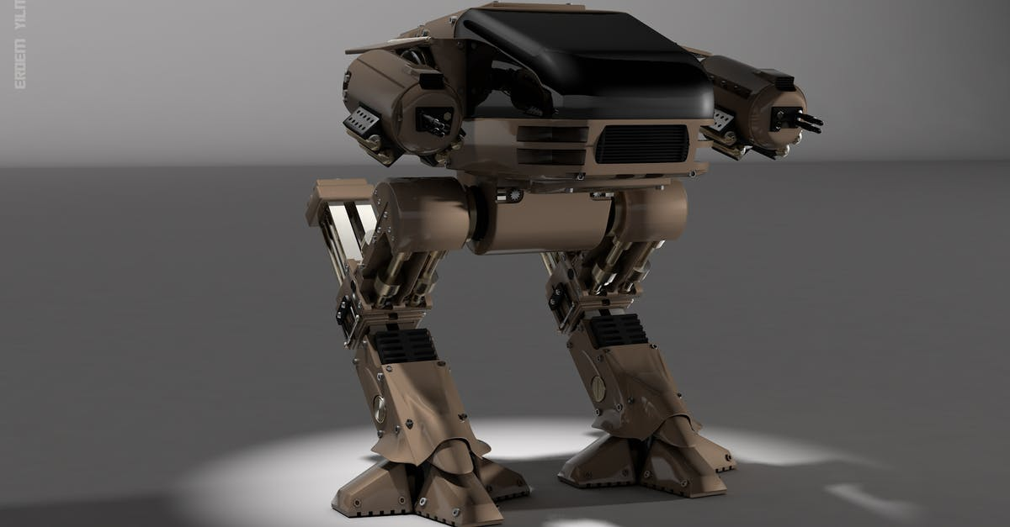
The problem statement is to design a robotic brain that tells a given robot how to avoid obstacles while navigating from a fixed starting position to a fixed destination position in an NxN matrix-based room avoiding the obstacles covering the cells of a matrix that should be randomly assigned in the room before the robot starts moving.

Slide 6
Project Phases
In Phase 1, we came up with a basic design and an algorithm for our problem statement.
In Phase 2, we wrote the code and executed it successfully, with certain limitations.
In Phase 3, we have given an overview on implementing the code in C language.
In Phase 4, we will be presenting the completed code.
Phase I | Algorithm & Design
Phase II | Code in Flowgorithm
Phase III | Overview of Design in C
Phase IV | Programming in C

Slide 7
02
Code Design - Overview

Slide 8
Flowgorithm to C
Initially, we recreated the flowgorithm code in C with limited changes in structure and approach
Step 1
We made use of the 2D array functionality in-built in C for better efficiency and memory management
Step 2
We created similar type of modules for various tasks in order to achieve respective outcomes
Step 3
Finally, we arrived at the completed code by debugging and making it more compatible with the C language
Step 4

Slide 9
03
Modules

Slide 10
Modules used in our Program
Main
Arena
PrintGrid
The main function just calls all the other modules
This module initializes values for each array index
This module prints the main grid and are called wherever necessary
FinalDest
InitialPos
Obstacles
PathPlan
This module specifies the position of the obstacles
This module determines the path of our robot.
This module specifies the final destination and initial position

Slide 11
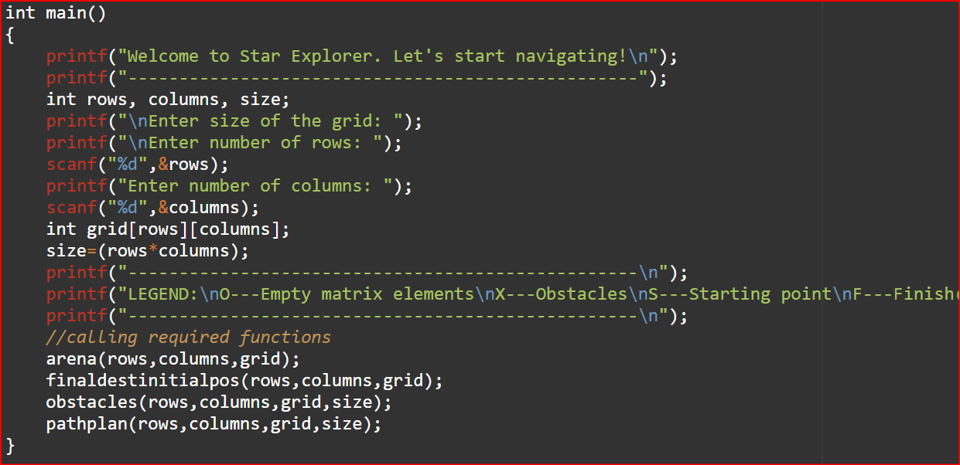
MAIN
MAIN FUNCTION
It is an integer type function
Declaration of variables – rows,
columns & size of int data type
Reading rows & columns from the
user
Declaring the integer array grid
with parameters rows & columns
Assigning the size of the grid
Calling all the other modules with
respective parameters

Slide 12
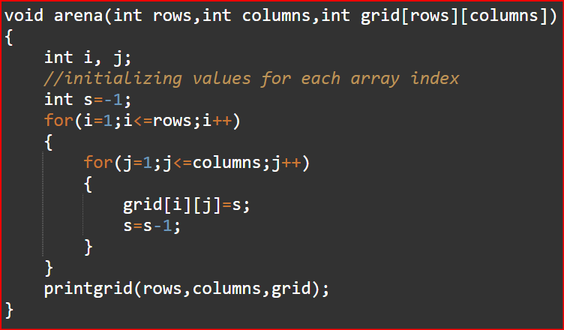
ARENA
ARENA FUNCTION
It is a void function with
parameters rows, columns & grid.
It initializes values for each array
index.
We have used “for” loops for
corresponding rows and columns
and have initialized negative
values starting from -1 and
decrementing for each array
element.
We call the “printgrid” function.

Slide 13
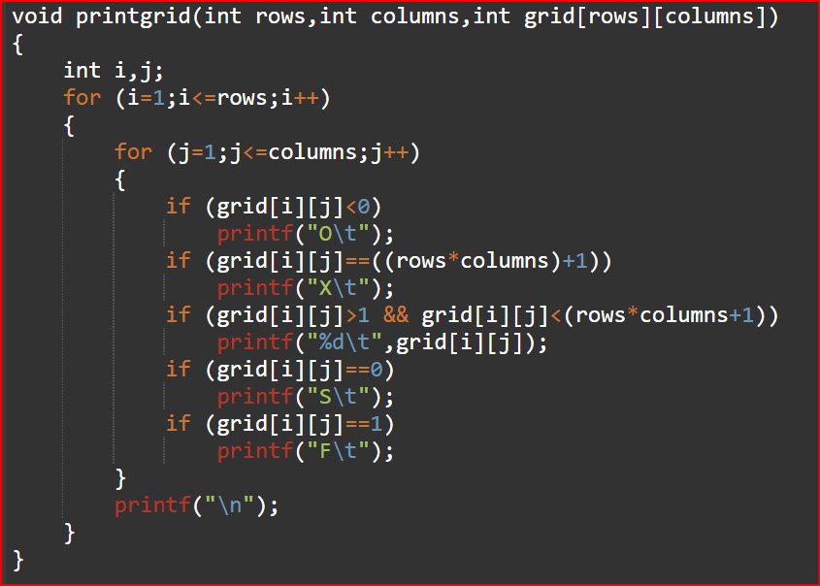
PRINTGRID
PRINTGRID FUNCTION
It is a void function with
parameters rows, columns, grid &
size.
It is used to print the grid when
called.
When called in “arena ( )”, it
prints “O” for the arena elements.
When called in
“finaldestinitialpos ( )”, it prints “F”
for the final destination and “S”
for initial position.
When called in the “obstacles ( )”,
it prints “X” for all the obstacles.

Slide 14
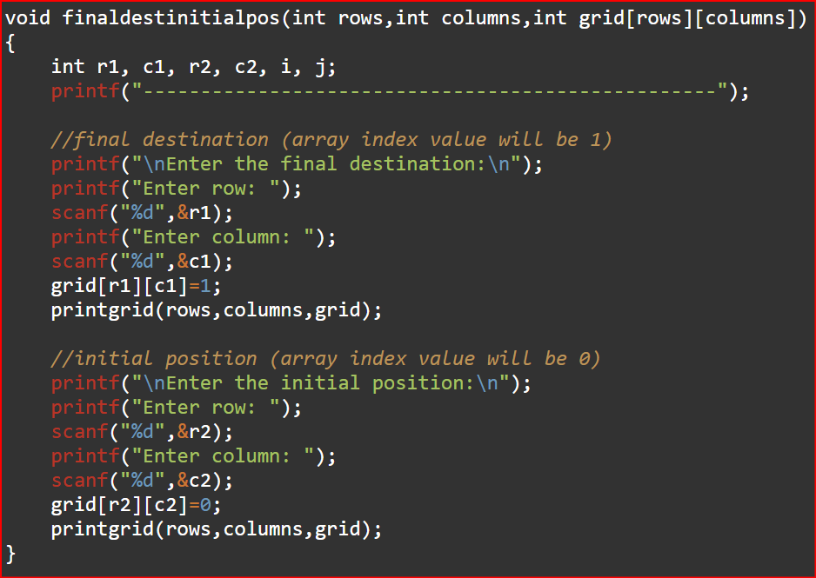
FINALDESTINITIALPOS
FINALDESTINITIALPOS FUNCTION
It is a void function with
parameters rows, columns & grid.
It is used to read and initialise the
initial position and final destination
to the grid.
The final destination is assigned to
the grid using parameters r1 and c1
and it’s array index value will be 1.
The initial position is assigned to
the grid using parameters r2 and c2
and it’s array index value will be 0.
We call the “printgrid” function.

Slide 15
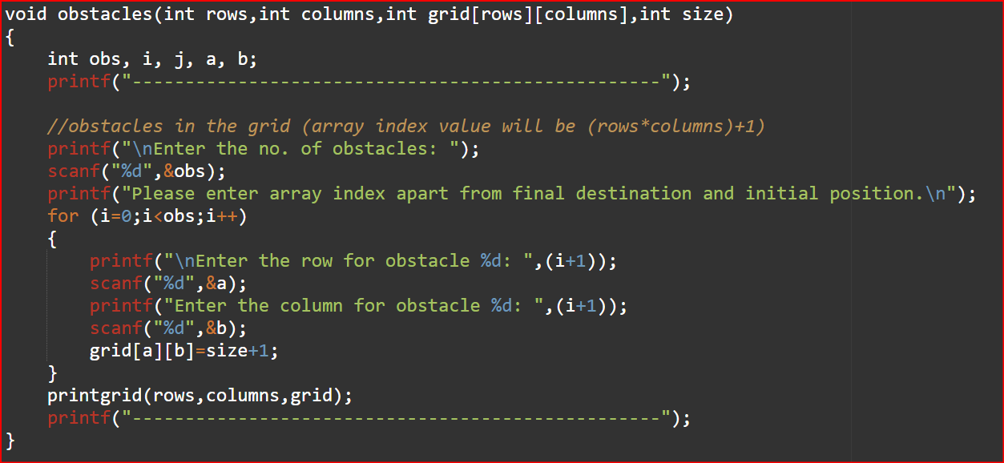
OBSTACLES
OBSTACLES FUNCTION
It is a void function with
parameters rows, columns, grid &
size.
It is used to read and initialise the
obstacles in the grid.
The obstacles are assigned to the
grid using parameters a and b and
their array index value will be
size+1.
The obstacle values are initialized
using a “for” loop until the total
number of obstacles have been
assigned to their value.
We call the “printgrid” function.

Slide 16
PATHPLAN
Up
Left
Right
Down
It is a void function with parameters rows, columns, grid & size.
It determines the course of our robot and displays the possible paths from which the shortest path is detected.
An int variable g is initialized as 1 and is incremented each time the robot moves to a new position until it reaches the initial position.
It checks a given set of conditions for (i-1, j) and determines whether the robot can move one position up.
It checks a given set of conditions for (i, j-1) and determines whether the robot can move one position down.
It checks a given set of conditions for (i, j+1) and determines whether the robot can move one position right.
It checks a given set of conditions for (i+1, j) and determines whether the robot can move one position down.

Slide 17
04
Analysis

Slide 18
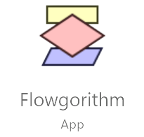

Flowgorithm vs C
vs
In flowgorithm, we were limited to using one dimensional arrays.
Whereas in C, usage of multi dimensional arrays makes it easier to
store values in matrix format which was used for creating the grid.
In flowgorithm, we used breakpoints whose function is to
temporarily stop the code by pausing it and not terminating it once
the output is printed. Whereas in C, we use the in-built exit ( ) to
terminate the code once we reach the desired output.

Slide 19
Advantages in C
Saves time by directly creating 2-D array and makes it simple rather than representing 1-D as 2-D in flowgorithm
Use of functions and it’s simple representation makes the code easier to understand
With C functionalities , we were able to beautify the code and display a more presentable output
C displays warnings & errors making it easier to trace the code and debug it

Slide 20
SWOT Analysis on C
Strengths
Weaknesses
S
T
W
C
Opportunities
Threats
O
Creating a multi dimensional array
Graphical representation of the grid was not possible
A C program is compatible and can be used to communicate with computers and tell them what to do
Run time errors such as buffer overflows occur and cause the program to crash

Slide 21
Thank You

